Slide 1
SHOOTING AT FLORIDA HIGH SCHOOL
Name:
Tutor:
Institution:

Slide 2
introduction
A 19-year-old former student by the name Cruz is held in custody as a suspect in the killings.
More than 17 people are murdered, and a dozen of others injured at Marjory Stoneman Douglas high school.
Cruz was flagged to be a campus threat in previous years and was expelled for disciplinary cases.
He was captured after being seen from a school security video while concealing himself in the crowd trying to run off.
According to Sun Sentinel, Cruz was adopted at birth, and his parents died that he had to live with his brother.
However, detectives are determined to investigate the matter by first digging up Cruz's social media accounts.

Slide 3
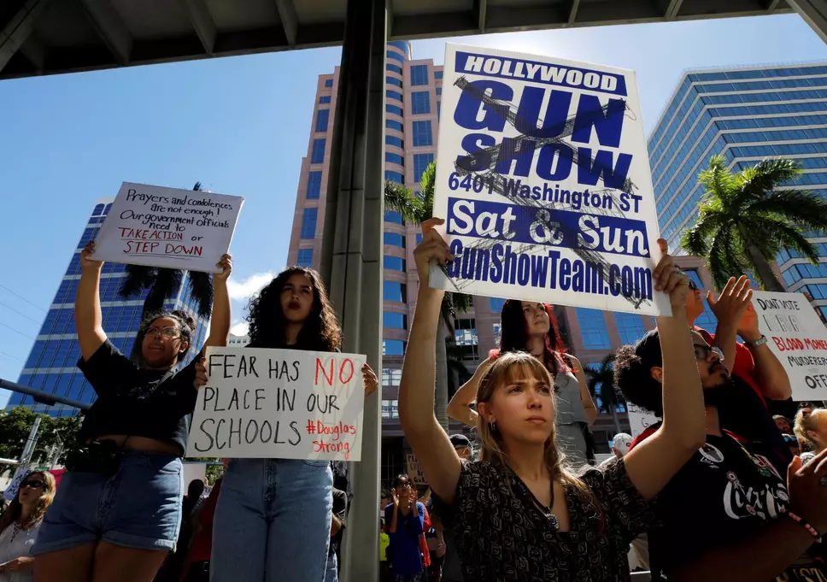
continuation

Slide 4
conclusion
It is believed that the killer used AR-15 rifle and a handgun at the shooting.
Conversely, one student had managed to text his parent about the gunshots happening in their school.
Sen. Bill Nelson was dedicated to ensuring the availability of federal resources.
Later on, President Trump gave his condolences, and through enforcement of the law, all the flags were lowered statewide to honor the lifeless.
Nevertheless, those shooting with 17 deaths were marked as among the worst in the modern history.
QUESTION: Do you think Cruz was found guilty?

Slide 5
references
http://cbs12.com/news/local/shooting-at-marjory-stoneman-douglas-high-school-in-parkland

